Slide 1

… from SPECTRUM
NATIONAL AIDS CONTROL COUNCIL
National Estimates Reference Group

Slide 2
Some Key Indicators of Interest
Access to treatment (90–90–90 targets).
Eliminating new HIV infections among children.
Access to prevention options among key populations.
A Kenya free of HIV Infections, Stigma and AIDS related deaths

Slide 3
Summary of 2019 Kenya AIDS Update Report
A Kenya free of HIV Infections, Stigma and AIDS related deaths

Slide 4



Access to Treatment (90–90–90 Targets)
Total 1,067,636 [68%] PLHIV on ART
90% of those who are HIV positive identified
74,344 [60%] Children
On ART
312,594 [59%] Male on ART
680,698 [75%] Female on ART
Stabilized retention rates:
90% Overall Retention Rates at 12 Months
90% of those identified are on ART
93% among Children
89% among Male
91% among Female
90% of those on ART are virally suppressed
77 % Overall Viral Load Suppression Rates

Slide 5




Eliminating New HIV Infections Among Children
Early Infants Diagnostic (EID)
71,100 first EID tests done
42,422 infants receiving biological test for HIV within 2 months of birth
Increase in uptake of pregnant women living with HIV receiving PMTCT
1.7 million estimated no of pregnancies
62,995 women identified (tested positive + known positives)
57,523 (91%) pregnant women receiving antiretroviral medicines (PMTCT)
Mother-to-Child Transmission of HIV (MTCT)
12.3% of children infected with HIV from MTCT
Modest coverage of syphilis testing among women attending antenatal care services at any visit
71% coverage; with about 1.2 million women tested for syphilis at ANC
A Kenya free of HIV Infections, Stigma and AIDS related deaths

Slide 6


Access to combination prevention options among gen pop
Voluntary Medical Male Circumcision (VMMC)
93% of men 15-49 years are circumcised*
286,899 males voluntary circumcised in 2018 out of a target of 180,316~ 159% coverage
Condom distribution and usage
109.6 Million condoms distributed in 2018 ~~
8.4 condoms per man per year against global target of 40 condoms per man per year
40% females reported using condom at last high-risk sex
44% males reported using condom at last high-risk sex
* KDHS Report 2014
A Kenya free of HIV Infections, Stigma and AIDS related deaths
Notes:
Key highlights:
There has been continued scale-up of vmmc program
A decrease in number of condoms distributed per man per year from 14.3 (2017) to 8.4 (2018)

Slide 7

Co-managing TB and HIV treatment
Total number of people living with HIV having active TB
Of 155,377 people newly enrolled in HIV care, 22,281(5%) had active TB
Number of HIV-positive new and relapse TB patients started on TB treatment
22,281 PLHIV started on TB treatment
20,878 (94%) adults
Male 12,068 (54%)
HIV/NCD
Estimates
Validation and Launch
1,403 (6%) children
Female 10,213 (46%)
A Kenya free of HIV Infections, Stigma and AIDS related deaths
Notes:
The slide to be updated in the course of the day

Slide 8
Kenya HIV Estimates 2018
A Kenya free of HIV Infections, Stigma and AIDS related deaths

Slide 9
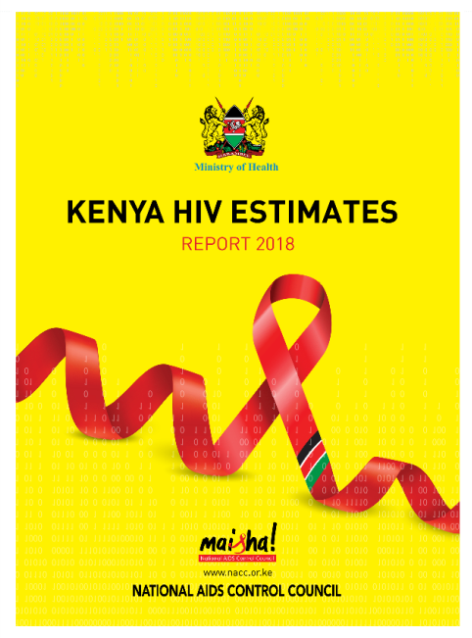
HIV Estimates
Kenya uses Spectrum Model – a globally validated system approved by UNAIDS, WHO used by 160 countries (http://www.epidem.org)
Spectrum provides tools to answer questions that are hard to measure directly in many settings
Estimates validated in-country by Strategic Information TWG and externally by UNAIDS Reference Group on Estimates, Modelling and Projections
Break down complex proportions to absolute #’s
Facilitate planning, prioritization, resource mobilization & allocation
A Kenya free of HIV Infections, Stigma and AIDS related deaths

Slide 10
HIV Burden 2019 projection vs 2018 projection
A Kenya free of HIV Infections, Stigma and AIDS related deaths

Slide 11
HIV incidence 2019 projection vs 2018 projection
A Kenya free of HIV Infections, Stigma and AIDS related deaths
Notes:
HIV incidence has continued to decline over the years
We are closer to the epidemic control target of <1/1000 incidence; however, the absolute numbers will be required to continuously decline

Slide 12
Treatment Coverage 2019 vs 2018
In 2019, we changed the source of ART numbers from the historically used ‘commodity’ reported data to ‘service delivery’ numbers from dhis2
Historically, the ‘service delivery’ data has often been lower than the ‘commodity’ data.
Due to this, there is an ‘artificial decline’ in ART numbers from 1.12M in 2017 to 1.067 in 2018.
Adults: 1,035,615 in 2017 to 993,292 in 2018 (4% ‘decrease’)
Children: 86,323 in 2017 to 74,344 in 2018 (14% ‘decrease’)
A Kenya free of HIV Infections, Stigma and AIDS related deaths

Slide 13
Changes in MTCT transmission/efficacy assumptions
New evidence on MTCT transmission / efficacy were implemented in the model in 2019
The net effect resulted in a higher MTCT rate in 2019 projection (blue-solid line) compared to 2018 projection (orange-solid line)
Nonetheless, the 2019 projection shows a decline in MTCT rate in 2019 (12.3%) compared to 2018 (14.2%)
A Kenya free of HIV Infections, Stigma and AIDS related deaths

Slide 14
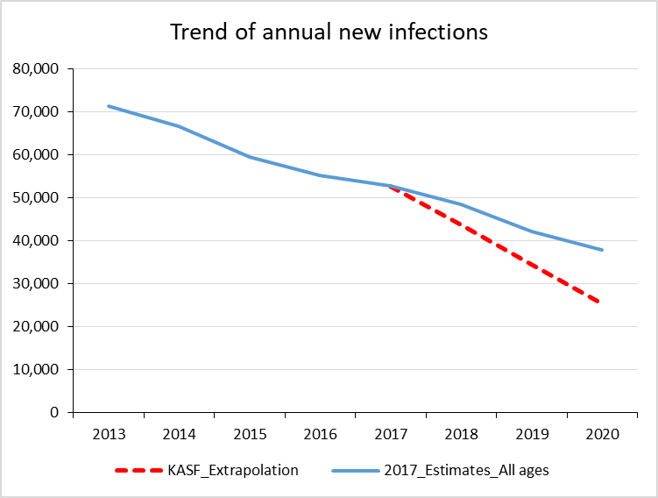
Assessing epidemic control and KASF performance
Target 2019 | 2018 estimates
KASF Goals
Reduce new infections by 75% | 54% (all ages)
Reduce AIDS-related deaths by 25% | 56% (all ages)
Increase Domestic Financing by 50% | 125%
Epidemic Transition or Control
Reduce incidence below 1.0 / 1,000 | 1.04 (all ages)
Reduce incidence/prevalence ratio below 0.03 | 0.03 (15+)
Reduce incidence / mortality ratio below 1.0 (with ART>81% and VLS>73%) | 1.91 (15+)
Notes:
More progress required to attain the KASF goal on reduction of new infections – HIV prevention remains critical component to attain this goal
The country is closer to achieving epidemic control, but still more work to be done

Slide 15
Key reflections…
Scale-up and retention of PMTCT remains critical
Increase coverage of 1st ANC visit (~90%)
Improve retention in ANC (~30-50% 4th ANC coverage), which ultimately affect the retention on ART
Improve ART uptake among women identified (91% HAART coverage)
Optimize testing at ANC
Testing scale-up urgently required to increase treatment uptake
Sustain treatment scale-up and adherence- Increase quality of care and in particular treatment monitoring and adherence
Single national pipeline – key for continued stocks monitoring
County engagement and prioritization of the HIV response must continue – routine reporting of the CASPS
Scale-up combination prevention across populations and geographies

Slide 16
Future data considerations
Sustainability of gains.
Prevention data- (Community and structural).
HIV co-morbidities (NCDs).
Need for financing data.
Routine financing data
Comprehensive KNASA before the next reporting
Notes:
Structural indicators – Education, Social Security, infrastructure

Slide 17

Next Steps… for all partners
Stakeholders remain the backbone to all the achievements
GAM Reporting to the Global level
Supporting attainment of UHC targets
Plans for modes of transmission study
*KENPHIA – data point to be included in 2020 estimates
KASF addendum review and end-term review
National Government
County Government
Development Partners
Public & Private sectors
Women & youth movements
People Living with HIV
Civil Society Organizations & Key populations
A Kenya free of HIV Infections, Stigma and AIDS related deaths

Slide 18
With special Thanks to Joshua Gitonga, Kennedy Mutai, Henry Domisoni, Peter Young, John Stover …
END-
A Kenya free of HIV Infections, Stigma and AIDS related deaths

Slide 19
Acknowledgements
Joshua Gitonga, Kennedy Mutai, NACC
Peter Young, CDC
Henry Domisoni, UNAIDS
UNAIDS Reference Group on Estimates,
John Stover, Avenir Health, Inc.
National Modelling SI

